Slide 1
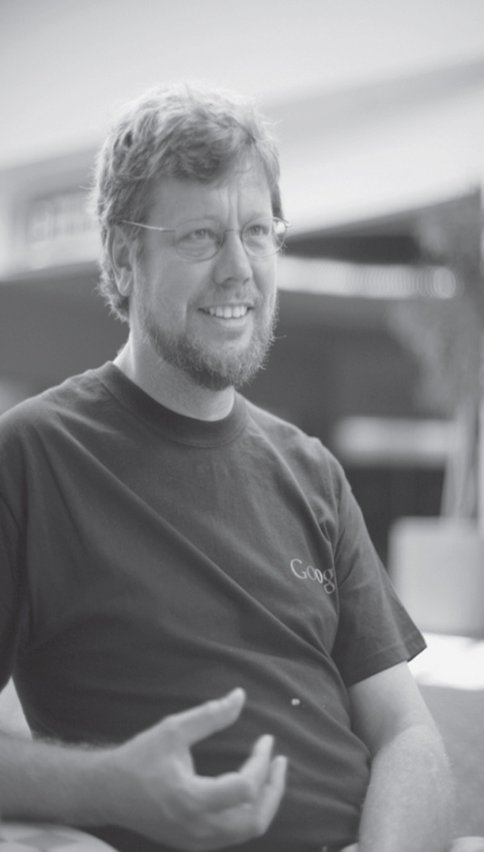
The Python Programming Language
What is Python ?
“Python is a programming language that lets you work quickly”
The Python Programming Language was created by Guido van Rossum. It was first released in the early 1990s.
Its name comes from a 1970s British comedy sketch show called Monty Python’s Flying Circus (The Argument Clinic).

Slide 2
#program to add two numbers
num1=int(input("Enter first number"))
num2=int(input("Enter second number"))
res=num1+num2
print("sum of two numbers is ",res)

Slide 3
A Bit of Python
We introduce a bit of Python, just enough to begin writing some simple programs.
Since all computer programs,
input data
process the data
output results
we look at the notion of a variable, how to perform some simple arithmetic calculations, and how to do simple input and output.

Slide 4
Keywords (if, for, while…)
Variables(sum, length…)
Basic
components
of a program
Constants (10, 20, 3.14..)
Operators (+,-,*,/,%)
Special symbols(#, $,()….)
User defined functions/Modules

Slide 5
Keywords :
It has fixed meaning which cannot be changed is called keyword or reserved word.
Examples: if, for, while, int, break...etc.
Don’t use Keywords for naming variables

Slide 6
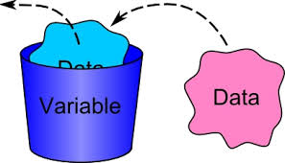
Variable:- A quantity which changes during the program execution and it is used to store data is called variable.
Rules for declaring variables:
It should not be a keyword.
It should not begin with digit.
It should not contain any blank space.
It should not contain any special char such as $, #.....
Conventions
Create a name that makes sense
Use camelCase notation to declare a variable
Example: myName myAge myAddress

Slide 7
Variables
One of the most fundamental concepts in programming is that of a variable.
A variable is “a name that is assigned to a value,” as shown below,
n = 5 variable n is assigned the value 5
Thus, whenever variable n appears in a calculation, it is the current value of n is that is used, as in the following,
n + 20 (5 + 20)
If variable n is assigned a new value, then the same expression will produce a different result,
n = 10
n + 20 (10 + 20)

Slide 8
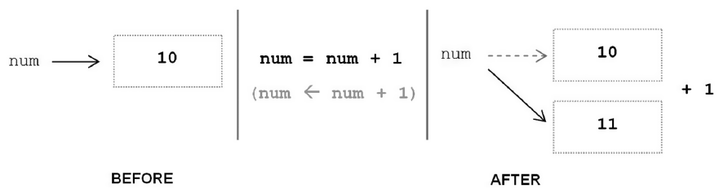
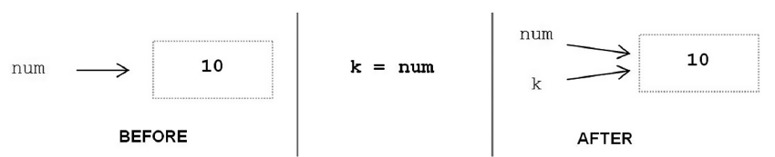
Variables in Python
Num=10
10
Num

Slide 9
Checking type of the variable
-------------------
a=10
print(a,type(a))
a=1.5
print(a,type(a))
a="Kumar"
print(a,type(a))
a=True
print(a,type(a))
a=1+4j
print(a,type(a))

Slide 10
Valid and invalid variables
variable
valid/invalid
reason/remarks
sum
valid
a
valid
for
invalid
Keyword
for1
valid
No semantic, avoid
2sum
invalid
beginning wit digit
$sum
invalid
Special char $
emp_name
valid

Slide 11
Constant /literal
“A literal is a sequence of one of more characters that stands for itself”
It is a quantity that does not change during program execution.
Ex : 10, 20, 3.14, 60, “Hello”.......
PI =3.14
G=6.7x10⁻¹¹
g= 9.8
Numeric literals
10,3,14 etc
Constants/
literals
Boolean literals
True ,False
String literals
“
kumar
” , “ram” etc

Slide 12
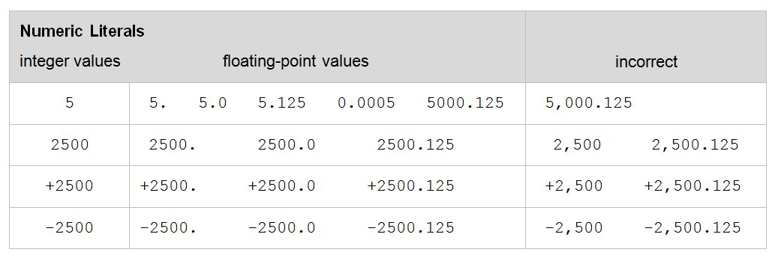
Examples
Commas are never used in numeric literals .

Slide 13
Some Basic Arithmetic Operators
The common arithmetic operators in Python are,
+ (addition) * (multiplication) ** (exponentiation)
- (subtraction) / (division)
Addition, subtraction, and division use standard mathematical notation,
10 + 20 25 - 15 20 / 10
(Also, // for truncated division, discussed later)
For multiplication and exponentiation, the asterisk (*) is used,
5 * 10 (5 times 10) 2 ** 4 (2 to the 4th power)
Multiplication is never denoted by the use of parentheses,
10 * (20 + 5) CORRECT 10(20 + 5) INCORRECT

Slide 14
Basic Input
The programs that we will write request and get information from the user. In Python, the input function is used for this purpose,
name = input('What is your name?: ')
Characters within quotes are called strings. This particular use of a string, for requesting input from the user, is called a prompt.
The input function displays the string on the screen to prompt the user for input,
What is your name?: Charles
The underline is used here to indicate the user’s input.

Slide 15
Input function
input() Parameters
The input() method takes a single optional argument:
prompt (Optional) - a string that is written to standard output (usually screen) without trailing newline
Return value from input()
The input() method reads a line from input (usually user), converts the line into a string by removing the trailing newline, and returns it.

Slide 16
Basic Output
The print function is used to display information on the screen in Python. This may be used to display a message (string),
>>> print('Welcome to My First Program!')
Welcome to My First Program!
or used to output the value of a variable,
>>> n = 10
>>> print(n)
10

Slide 17
print Function
The print() function
prints the given object to the standard output device (screen) or to the text stream file.
The arguments of the print function are the following ones:
print(value*, ..., sep=' ', end='\n', file=sys.stdout, flush=False)
print() Parameters
value - values to be printed. * indicates that there may be more than one object
sep - values are separated by sep. Default value: ' '
end - end is printed at last
file - must be an object with write(string) method. If omitted it, sys.stdout will be used which prints objects on the screen.
flush - If True, the stream is forcibly flushed. Default value: False

Slide 18
print Function
#1. use constructs which has beginning and ending markers - like a pair of parentheses
print(
"Python"
)
# 2. enter \ (backslash) before pressing <Enter> key - this is called escaping.
print \
(
"Programming"
)
# multiple statements on a single line separated by ;
print("Python"); print("Programming")

Slide 19
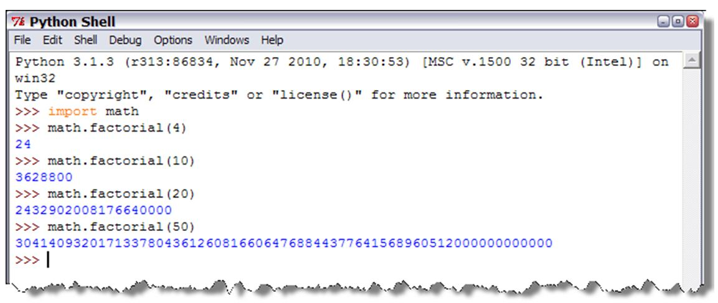
Writing python programs/Ways of talking in python
1 ) Interactive mode
2. Batch mode

Slide 20
The IDLE Python -Development Environment
IDLE is an integrated development environment (IDE). An IDE is a bundled set of software tools for program development. This typically includes,
an editor
for creating and modifying programs
a translator
for executing programs, and
a program debugger
for taking control of the execution of a program to aid in finding program errors

Slide 21
Using IDLE
In order to become familiar with writing your own Python programs using IDLE, we will create a simple program that asks the user for their name and responds with a greeting. This program utilizes the following concepts:
➤ Creating and executing Python programs
➤ Input and print functions

Slide 22
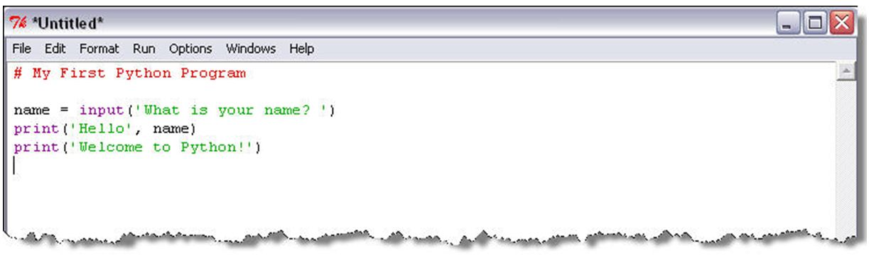
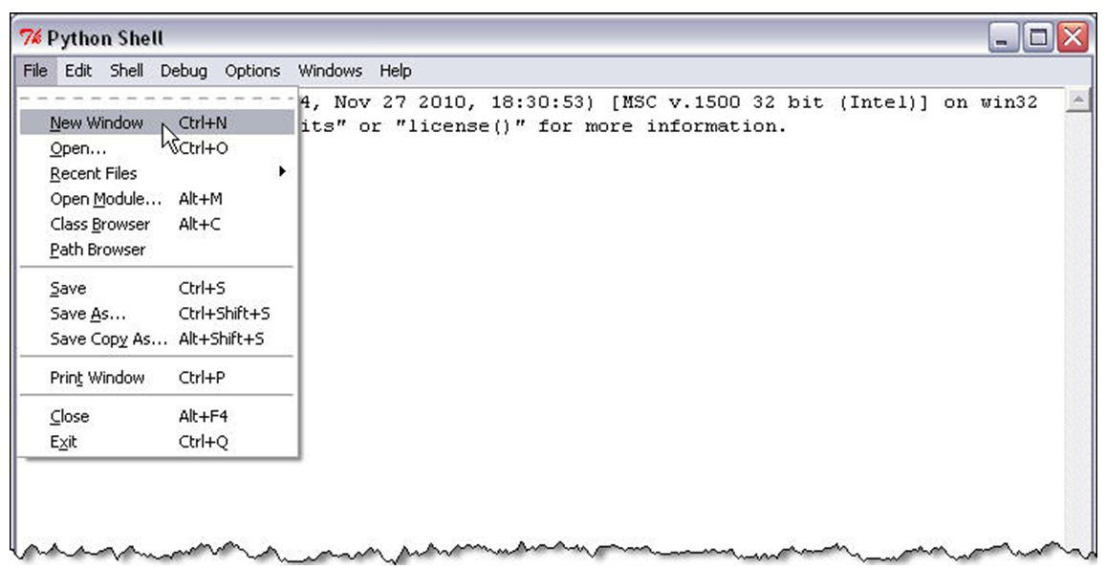
Creating a New Python Program

Slide 23
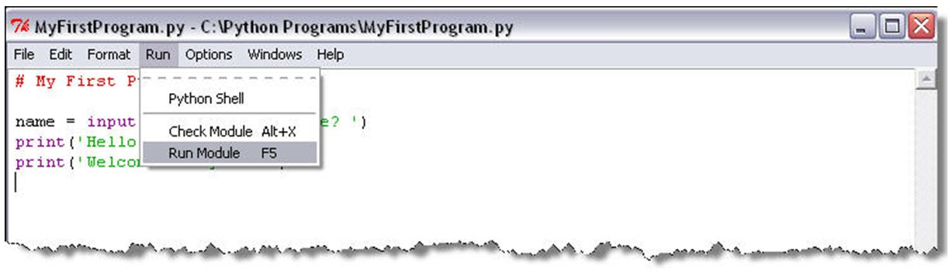
Executing a Python Program

Slide 24




Question : Design and develop solution to find simple interest
Problem
step1 : start
step2 : read P, T, R.
step3 : find SI=PTR/100;
step4 : print SI
step5 : stop
Algorithm
Flow chart
Analyst
OR
Designer
#program to find Simple interest
P=int(input("Enter the Price"))
T=int(input("Enter the Time"))
R=int(input("Enter the Interest rate"))
SI=(P*T*R)/100
print("The area of circle is ",SI)
Program
Testing
programmer
tester

Slide 25
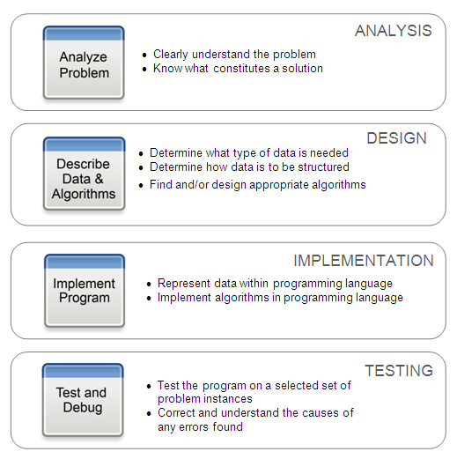
Computational Problem Solving Steps

Slide 26
Properties of good algorithms
It consists of finite number of steps.
It should be clear (no confusion)
It should produce correct output.
It should terminate after producing the output.
It should handle the unexpected situations such as division by zero.
Every step of algorithm should perform a single task.

Slide 27
Advantages of Algorithm :
Effective communication : better way of communicating the logic between various development teams in software development.
Effective Analysis : Problem can be Analyzed effectively.
Input, output and processing can be analyzed
Used in proper documentation of the problem.
Document used for future maintenance.
It helps in program debugging.
To remove errors

Slide 28
To find the given number is even or odd
Determine type of data needed
10,20,30,7,2 (integer data)
Determine how data is structured or stored
Num=10 ( a variable to store data)
Determine the logic
if(num%2==0) then
even
else
odd

Slide 29
Find the given number is even or odd.
step1 : start
step2 : read the number num.
step3 : find even or odd
if(num%2 is 0)
print “Even”
else
print “Odd”
step4 : stop

Slide 30
Design and develop a solution to find the roots of a quadratic equation
Quadratic equation: An equation with the degree 2.
ax²+bx+c=0
Given a,b,c, find x
Inputs
a,b,c
Output
Roots r1, & r2
roots are :
(-b± √b²-4ac)/2a
disc= b*b-4*a*c
b²-4ac
is called
Discriminant

Slide 31
let disc= b*b-4*a*c
There are 3 cases, they are.
Case1 : if disc=0
r1=r2= -b/(2*a)
Case2 : else if disc>0
r1= (-b+sqrt(disc))/2a
r2= (-b-sqrt(disc))/2a
Case3 : else
print “complex roots”.
if(d>=0) :
r1 = (-b-math.sqrt(d))/(2*a)
r2 = (-b+math.sqrt(d))/(2*a)
print(r1,r2)
else :
print(“complex roots”)

Slide 32
Program to find the roots of a quadratic equation
import math
# To take coefficient input from the users
# a = float(input('Enter a: '))
# b = float(input('Enter b: '))
# c = float(input('Enter c: '))
# calculate the discriminant
d = (b**2) - (4*a*c)
if(d>=0):
# find two solutions
r1 = (-b-math.sqrt(d))/(2*a)
r2 = (-b+math.sqrt(d))/(2*a)
print(sol1,sol2,sep="\n")
else:
print("complex roots")

Slide 33
import math,cmath
# To take coefficient input from the users
# a = float(input('Enter a: '))
# b = float(input('Enter b: '))
# c = float(input('Enter c: '))
# calculate the discriminant
d = (b**2) - (4*a*c)
if(d>=0):
# find two solutions
sol1 = (-b-math.sqrt(d))/(2*a)
sol2 = (-b+math.sqrt(d))/(2*a)
else:
sol1 = (-b-cmath.sqrt(d))/(2*a)
sol2 = (-b+cmath.sqrt(d))/(2*a)
print(sol1,sol2)

Slide 34
Design program to find area of triangle(three sides are given)
# Python Program to find the area of triangle
$s = (a+b+c)/2
$area = √(s(s-a)*(s-b)*(s-c))
# Uncomment below to take inputs from the user
a = float(input('Enter first side: '))
b = float(input('Enter second side: '))
c = float(input('Enter third side: '))
# calculate the semi-perimeter
s = (a + b + c) / 2
# calculate the area
area = (s*(s-a)*(s-b)*(s-c)) ** 0.5
print('The area of the triangle is “,area)

